Slide 1
START
DATA COLLECTION
RAW + WET
plastics
leaf
DATA INTEGRATION

Slide 2
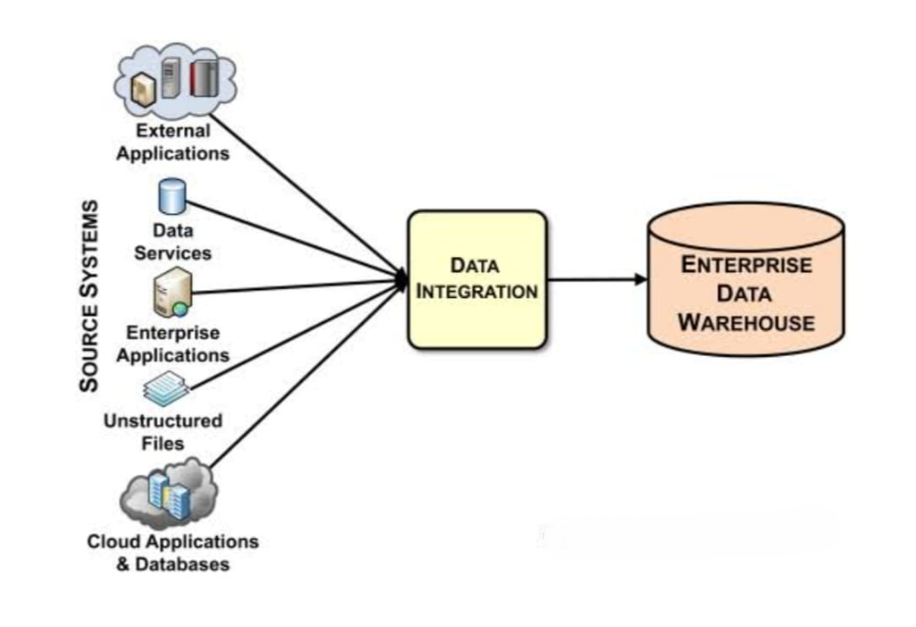
EXPLAINABLE PREDICTIVE MODELING AND TECHNIQUES

Slide 3
CNN
VISUALIZATION AND DECISION SUPPORT
POWER BI

Slide 4
END

